Slide 1
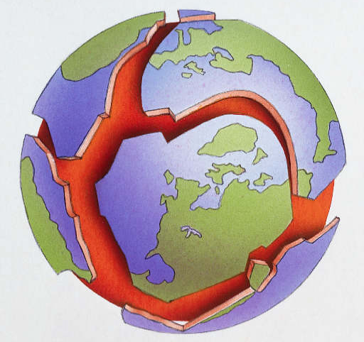
2. Plate Tectonics

Slide 2
Plate Tectonics
By the end of the lesson you should be able to:
Identify three major tectonic plates that make up part of the Earth’s crust.
Describe the direction of plate movement at each type of plate boundary.

Slide 3
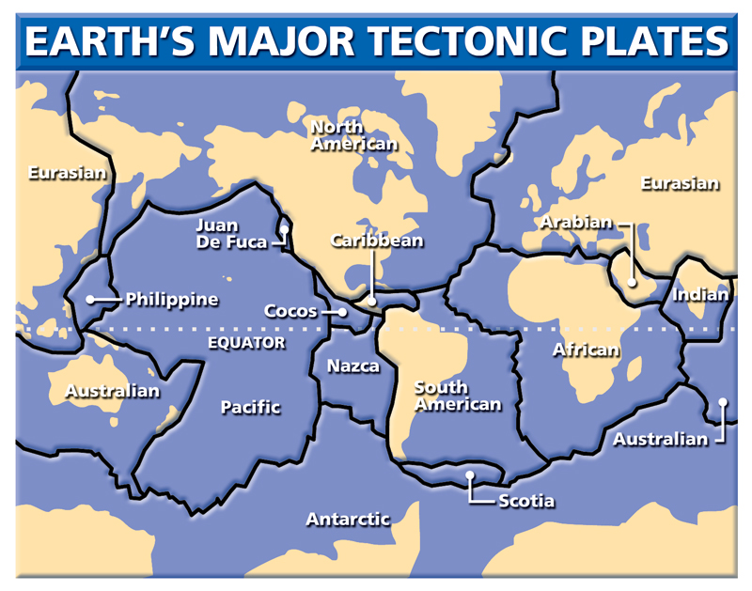
The Earth's surface is made up of large plates (like pieces of a jigsaw).
These plates are constantly travelling at a few centimetres per year.
The ocean floors are spreading from the centre and sinking at the edges.
Convection currents beneath the plates move the plates in different directions.

Slide 4
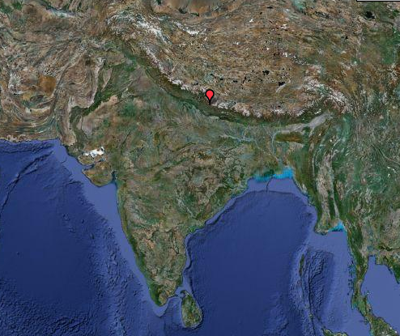
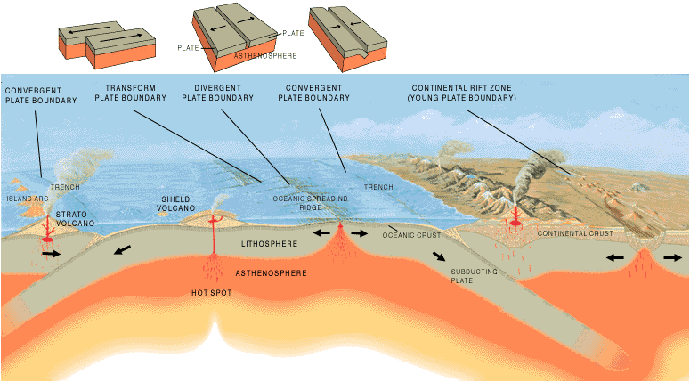
Eurasian Plate
Destructive Plate Boundary
Plate
Indian Plate
Plate
Mantle
A destructive plate boundary is where two plates push against each other causing violent earthquakes, volcanoes and mountain ranges to be formed.

Slide 5
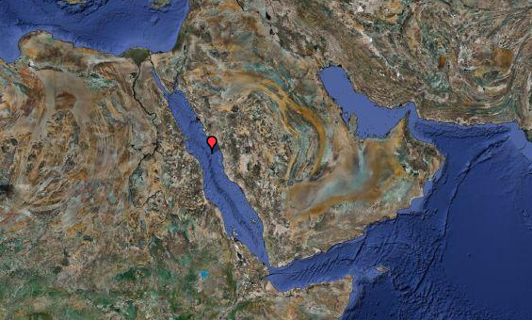
Constructive Plate Boundary
Plate
Plate
Mantle
Two plates move away from each other.
Molten rock (magma) rises from the mantle to fill the gap between the two plates.
Causes volcanoes and earthquakes but also forms mid-ocean ridges that develop into islands.
Arabian Plate
Red Sea
African Plate

Slide 6
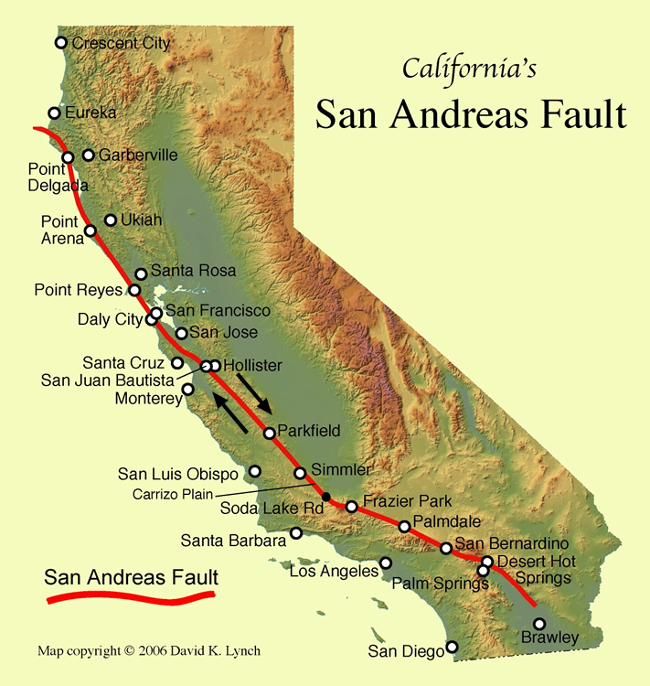
Conservative Plate Boundary
Causes earthquakes, which can be fairly violent and frequent.
Two plates slide past each other, without creating or destroying any land.
As they move past each other they often get stuck, building up great pressure until finally they jolt past each other. This sudden movement is what causes earthquakes.
Plates
Mantle

Slide 7
Show what you have learned
Using a blank map of the world identify the major plates that make up the Earth’s surface.
Draw and label the 3 types of plate boundaries.
Show the direction of movement at each type of plate boundary.
Describe the types of land formation and natural disasters that can occur at each plate boundary.

